Slide 1
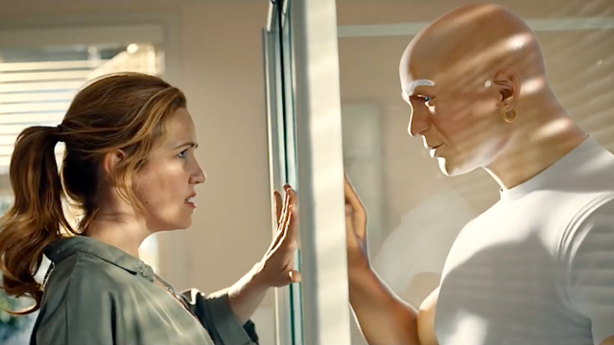
Aseptic Technique for Yeast Culture
Dan Schwarz
9.19.17

Slide 2

Why do we care about aseptic technique?

Slide 3
Why do we care about aseptic technique?
Control

Slide 4
Why do we care about aseptic technique?
Control
Control

Slide 5
Why do we care about aseptic technique?
Control
Control
Control

Slide 6
Why do we care about aseptic technique?
Control
  Bacteria/other fungus is a major competitive pressure
Control
Control

Slide 7
Why do we care about aseptic technique?
Control
  Bacteria/other fungus is a major competitive pressure
Control
  Sporadic contamination is not reproducible or specific
Control

Slide 8
Why do we care about aseptic technique?
Control
  Bacteria/other fungus is a major competitive pressure
Control
  Sporadic contamination is not reproducible or specific
Control
  Competitive pressure from a contaminant will confound your experiment

Slide 9
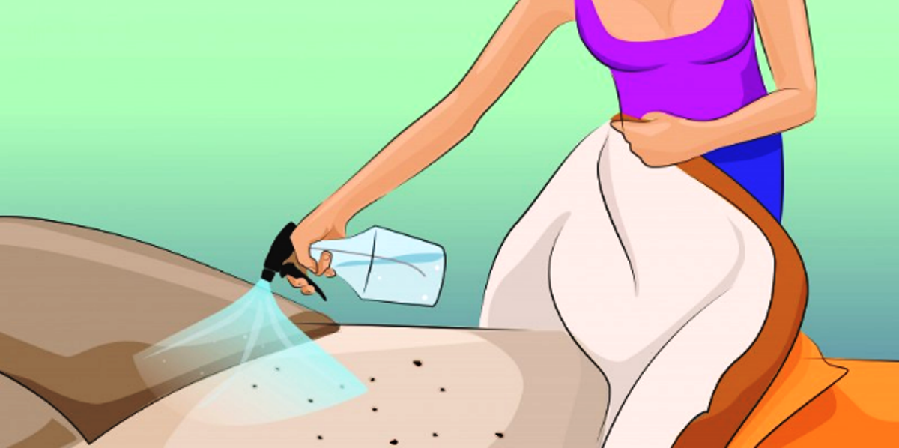
So what do we do?
Spray down working surfaces with 70% EtOH

Slide 10
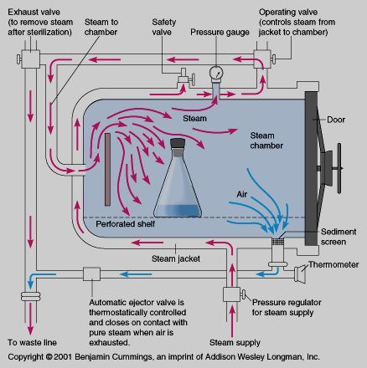
So what do we do?
Spray down working surfaces with 70% EtOH
Use sterile glassware, filter pipette tips, media, buffers, etc.
http://www.uvm.edu/safety/sites/default/files/autoclaveprocess.jpg

Slide 11
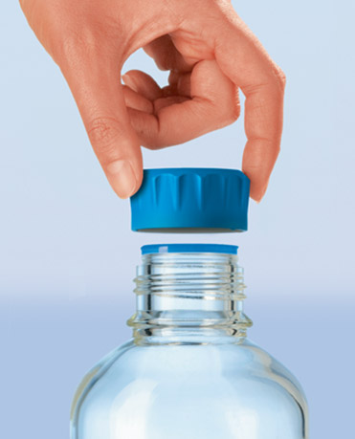
So what do we do?
Spray down working surfaces with 70% EtOH
Use sterile glassware, filter pipette tips, media, buffers, etc.
Keep things capped AS MUCH AS POSSIBLE

Slide 12
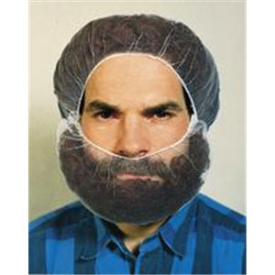
So what do we do?
Spray down working surfaces with 70% EtOH
Use sterile glassware, filter pipette tips, media, buffers, etc.
Keep things capped AS MUCH AS POSSIBLE
Avoid loose clothing/hair

Slide 13
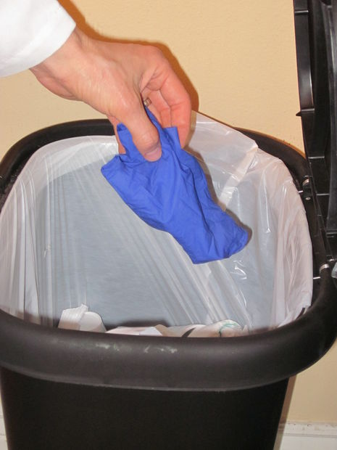
So what do we do?
Spray down working surfaces with 70% EtOH
Use sterile glassware, filter pipette tips, media, buffers, etc.
Keep things capped AS MUCH AS POSSIBLE
Avoid loose clothing/hair
Don’t touch your laptop/bag/food/water with your gloves

Slide 14
So what do we do?
Spray down working surfaces with 70% EtOH
Use sterile glassware, filter pipette tips, media, buffers, etc.
Keep things capped AS MUCH AS POSSIBLE
Avoid loose clothing/hair
Don’t touch your laptop/bag/food/water with your gloves
Be tidy!

Slide 15
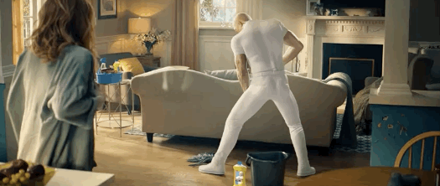
Any questions?

